Slide 1
Understanding Array in Java
Dr. Naveen Kumar
Associate Professor
Amity Institute of Information Technology
Amity University Patna

Slide 2
Algorithm
An algorithm is a Step-by-step procedure to solve a specific problem.
A program is also a step-by-step procedure to solve a specific problem.
An algorithm is an abstract concept. Whereas a program is a concrete implementation of the algorithm.
An algorithm can be written in any language, while a program must be written using a programming language only.
An Algorithm is developed during the design phase, and a program is developed during the development phase.
An Algorithm does not depend on the hardware and operating system, while a program depends upon them.
An algorithm is always analyzed, while a program is tested.

Slide 3
Introduction
Asymptotic Notations
Time Complexity
Time and Space Complexity of Recursive Algorithm
Methods to Solve Recurrence Relations
Divide and Conquer Algorithms
Greedy Algorithm
Dynamic Programming
Graph Representation and Traversal
Sorting Algorithms

Slide 4
Algorithm vs Program
Start
Initialize a variable ‘result’ to 1
Read the input number ’n’.
Repeat the following until n become 0:
Multiply result by n
Decrement n by 1
Print the value of result as the factorial
Stop
int fact(int n){
int result = 1;
while(n>0){
result *= n;
n--;
}
return result;
}

Slide 5
Characteristics of Algorithm
Input: An algorithm can take 0 or more inputs.
Output: An algorithm must produce at least 1 output.
Finiteness: An algorithm must terminate in finite time.
Definiteness: An algorithm must be clear and unambiguous.
Effectiveness: An algorithm should take less time and space to execute.

Slide 6
Significance of Algorithms
A bad algorithm can lead to longer execution time.
A good algorithm will lead to shorter execution time

Slide 7

Decidable Problems
The problem for which efficient algorithm exists.
Take polynomial time or less to execute.

Slide 8

Undecidable Problems
The problem for which no efficient algorithm exists.
Takes exponential time to execute.

Slide 9
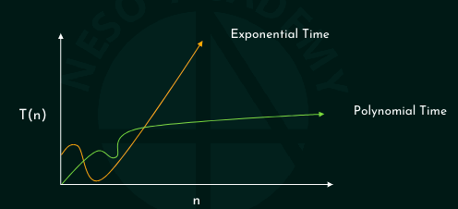
Polynomial vs Exponential Time

Slide 10
Study of an algorithm’s performance based on time and memory space consumption.
The algorithm taking least time and memory space is preferred.
Two ways to analyze an algorithm:
  Priori Analysis
  Posteriori Analysis

Slide 11
Priori Analysis vs Posteriori Analysis
Priori Analysis
Estimation of time and memory space required by an algorithm before executing it on the system.
Independent of the programming language.
Independent of the hardware.
Posteriori Analysis
Calculation of time and memory space required by an algorithm after executing it on the system.
Dependent on the programming language.
Dependent on the hardware.

Slide 12
Importance of Algorithm Analysis
There are many algorithms to solve a problem
The requirement is to find the most efficient algorithm to solve the problem.
Efficiency in terms of time and memory space consumption.
Key: 90
Total comparison: 7

Slide 13
Importance of Growth Rate
Linear Search vs Binary Search
100 items 100 items
100 comparison 7 comparison
I billion items 1 billion items
1 billion comparisons 30 comparisons
As the size of the input grows, the speed of the binary search grows drastically.
One example is not enough to analyse algorithms.
Importance to know how fast an algorithm grows w.r.t. the input size.
Definition: Rate at which the running time increases as a function of input is called the growth rate (can be measured using the Big O Notation).

Slide 14
Big O Notation
Way to describe the performance of an algorithm w.r.t. to the input size.
In linear search, the number of comparisons is directly proportional to the input size.
Linear Search
Number of Items Number of Comparisons
10 10
100 100
I million I million
N N
Running Time: O(N)

Slide 15
Big O notation does not tell speed in seconds.
It helps in comparing the number of operations.
O(n): number of operations

Slide 16
Big O notation and Binary Search
In binary search, every time half of the list is eliminated.
Binary Search
Number of Items Number of Comparisons
10 4
100 7
1 billion 30
N ?
O(logn): n, n/2, n/4, …, n/2^{k} ; n/2^{k}=1; 2^{k} = n; log₂2^{k} = log2n ; k = logn

Slide 17
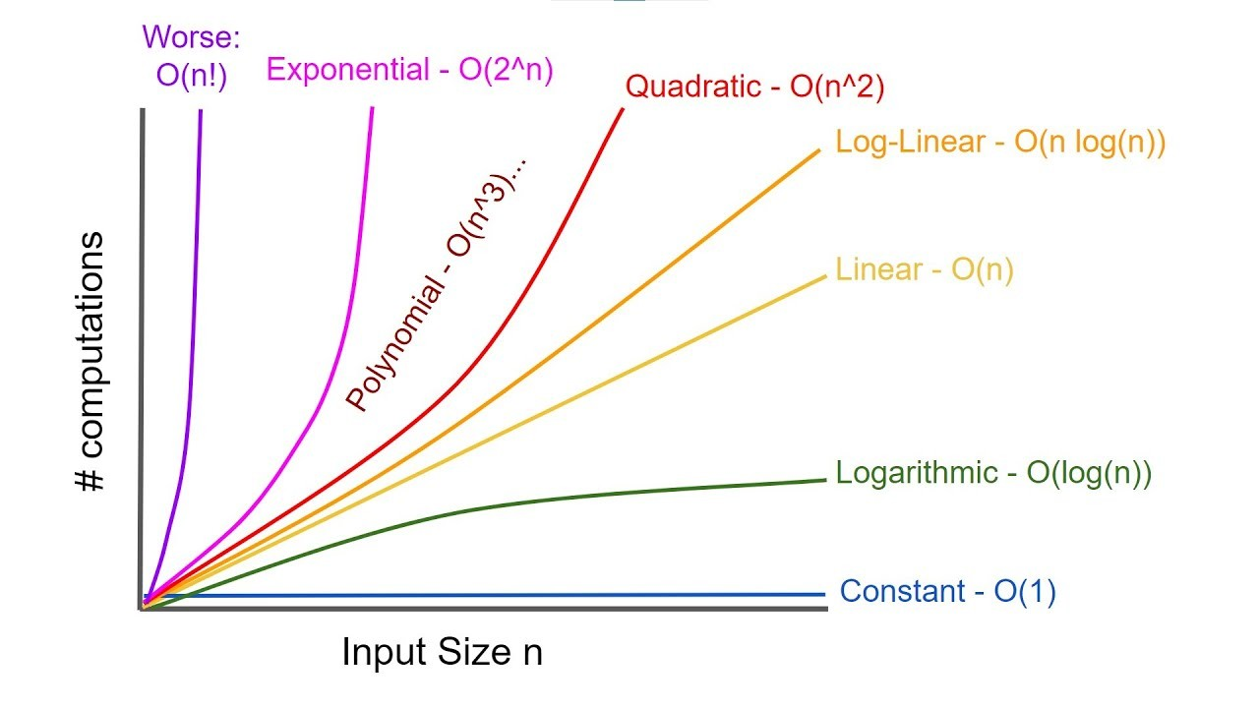

Slide 18
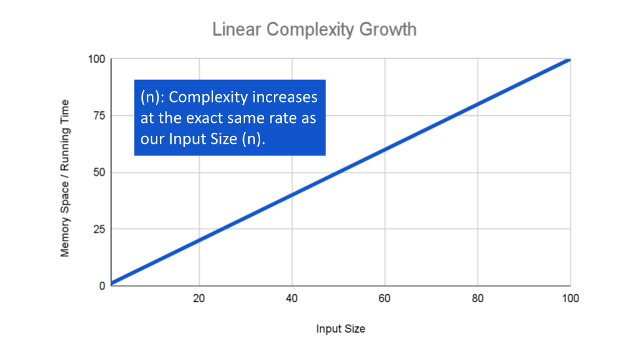

Slide 19
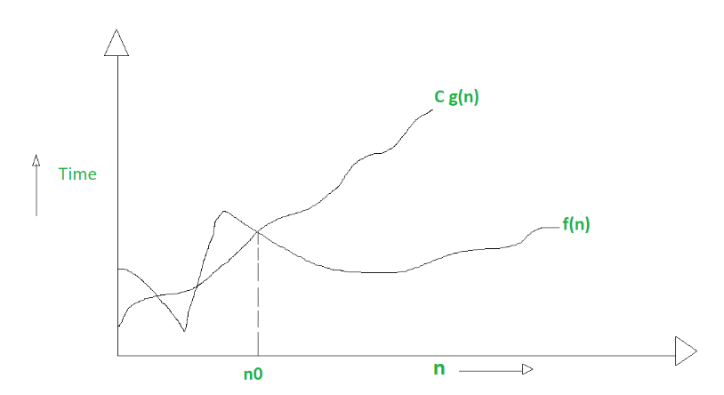
Formal Definition: Growth Rate Comparison
g(n) is asymptotically bigger
bigger than f(n)

Slide 20
Big-Oh Notation
Assuming f(n) and g(n) are non-negative functions.
f(n)=O(g(n)) iff f(n) <= c.g(n) for all values of n where n>= n₀ and c and n₀ are constants.
g(n) is the tightly upper bound of f(n).
g(n) is tightly greater than f(n).

Slide 21
1. Assume that f(n) = 5n+50 and g(n) = n. Is f(n) = O(g(n))?
Assume c = 6
5n + 50 6n
n=10; 100 60
n=20; 150 120
n=50; 300 300
n=51; 305 306
5n+50=O(n) for c=6 and n₀>=50

Slide 22
2. Assume that f(n) = 5n + 50 and g(n) = log₁₀n. Is g(n) upper bound of f(n).
Assume c = 1000
5n + 50 1000log10n
n=10; 100 1000
n=100; 550 2000
n=1000; 5050 3000
n=10000; 50050 4000
g(n) is not an upper bound of f(n)

Slide 23
3. Find upper bound for f(n) = 3n + 8
1: Identify the dominant term. Ie. 3n
2: Choose g(n) according to the dominant term.
N, nlogn, n², n³, 2^{n}, n! etc.
Apply the Big O definition
According to the definition of Big O notation: f(n) = O(g(n)) iff f(n) <= c.g(n) for all values of n where n>=n₀ and c and n₀ are constant.

Slide 24
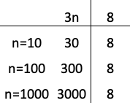
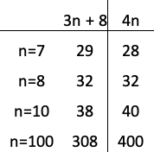
4. Find the upper bound for f(n) = 3n + 8.
1: Identify the dominant term.
2: Choose g(n) according to the dominant term.
Ie. n, nlogn, n², n³, ….. 3n is the dominant term.
3: Apply the Big O definition. According to the definition of Big O notation: f(n) = O(g(n)) iff f(n) <= c.g(n) for all values of n where n>=n₀ and c and n₀ are constants.
Assuming c = 4
3n + 8 <= 4n is true
3n + 8 = O9n) for c = 4 and n₀ = 8

Slide 25
Find the upper bound for f(n) = n² + 10
Find the upper bound for f(n) = 2n³ – 2n².
Find the upper bound for f(n) = n⁴ + 100n² +35.
Find the upper bound for f(n) = 2^{n} + 2n³
Find the upper bound for f(n) = 300.

Slide 26
Common Big O Notations
O(logn), also known as log time. (Binary Search)
O(n), also known as linear time. Linear search
O(nlogn). Quicksort
O(n2), also known as polynomial time. Selection sort
O(n!), also known as exponential time. Traveling salesman Problem.

Slide 27
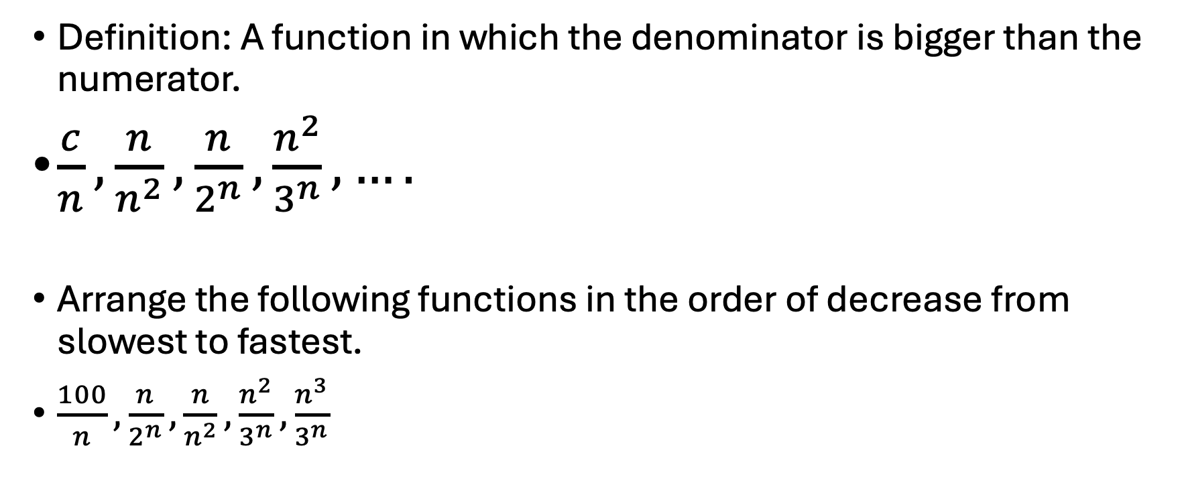
Decrement Functions
Definition: A function in which the denominator is bigger than the numerator.
$\frac{c}{n},\frac{n}{n^{2}}, \frac{n}{2^{n}}, \frac{n^{2}}{3^{n}}, ….$
Arrange the following functions in the order of decrease from slowest to fastest.
$\frac{100}{n},\frac{n}{2^{n}}, \frac{n}{n^{2}}, \frac{n^{2}}{3^{n}},\frac{n^{3}}{3^{n}}$

Slide 28
Constant Functions
A function parallel to x-axis
Examples: 100, 500392, 1 billion, etc.
Constant function is asymptotically bigger than the decrement function.
Problem: f(n): 100/n and g(n) = 10000. Is f(n) = O(g(n))?

Slide 29
Logarithmic Functions
A function that grows positively, but with slower growth rate.
Examples: logn, (logn)¹⁰, loglogn, loglogn.logloglogn, etc
Comparison with Constant Function
The logarithmic function is asymptotically bigger than the constant function.
Problem: f(n): 100 and g(n) = log₁₀n. Is f(n) = O(g(n))?

Slide 30
Polynomial Functions
A function whose growth rate increases polynomically.
Example: n^{0.1}, sqrt(n), nlogn, n^{k}, etc.
Comparison with logarithmic Functions
Problem: f(n) = log10n and g(n) = sqrt(n) = O(g(n))?

Slide 31
Exponential Functions
A function whose growth rate increases rapidly.
Example: 2n, 3^{n}, n!, n^{n}, a^{n}, etc.
The exponential function is asymptotically bigger than the polynomial function.
Problem: f(n) = n² and g(n) = 2^{n}. Is f(n) = O(g(n))?
Conclusion: Decreasing functions < Constant functions < Log Functions < Polynomial Functions < Exponential Functions.

Slide 32
Functions in Asymptotic Notations
Write the following functions in asymptotically increasing order: n2, n^{3.1}, n²logn, logn, (logn)¹⁰, 100, 1 billion, (0.3)^{n} and (1.5)^{n}.

Slide 33
Functions in Asymptotic Notations
Which of the following functions is asymptotically bigger?
f(n) = log₁₀n and g(n) = log₁₀log₁₀n

Slide 34
Functions in Asymptotic Notations
Which of the following functions is asymptotically bigger?
F(n) = log₁₀n and g(n) = (log₁₀log₁₀n)¹⁰

Slide 35
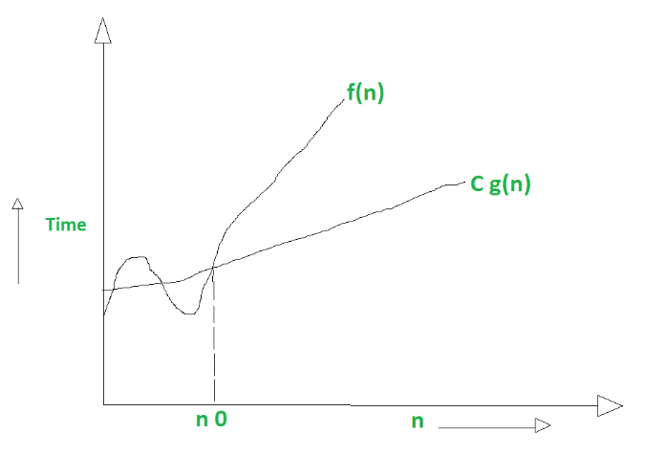
Big Omega Notation
Describe the lower bound of an algorithm.
Used to express the best case running time of an algorithm.
Definition: Assuming f(n) and g(n) are non-negative functions. f(n) = Ω(g(n)) iff f(n) >= c.g(n) for some c > 0 and for all values of n where n>= n₀ and c and n₀ are constants.
g(n) is the asymptotically tight lower bound
of f(n).

Slide 36
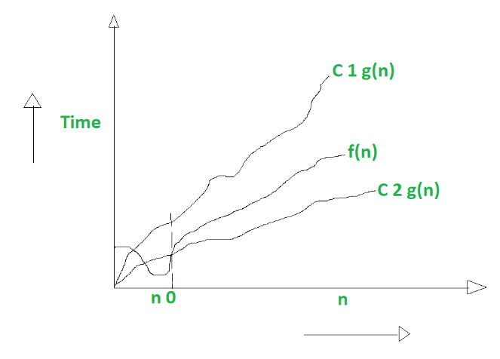
Big Theta
Definition: Assuming f(n) and g(n) are non-negative functions. f(n) = θ(g(n)) iff c1.g(n) <= f(n) <= c2.g(n) for all values of n where n >= n0 and c1, c2, and n0 are constants.
g(n) is the asymptotically tight bound of f(n).

Slide 37
Big omega notation - problems
Find the lower bound for f(n) = 10n² + 5?
Show that f(n) = n³ + 3n² = 𝜃(n³).

Slide 38
Understanding Time Complexity
Priori Analysis
Estimation of time and memory space required by an algorithm before executing it on the system.
Posteriori Analysis
Calculation of time and memory space required by an algorithm after executing it on the system.

Slide 39
CPU Consumption and Main Memory Space
CPU consumption refers to a task performed by the CPU or an instruction executed by the CPU.
Main Memory Space is used to temporarily store data and instructions that CPU needs for quick access during program execution.
Estimation of total CPU computations required to execute an algorithm.
Time Complexity of an algorithm = Total No. of CPU Computations = Sum of frequency count of each instruction of an algorithm.
Frequency count means number of time an instruction is executed.

Slide 40
Algo sum(a, n){
sum = 0
for(i=1; i<= n; i++)
sum = sum + a[i]
return sum
}

Slide 41
Understanding Space Complexity
Estimation of main memory space required to execute an algorithm.
Space Complexity of an algorithm =
  Space required to store the source code +
  Space required for simple variables +
  Space for the data structures used +
  Space required for stack for recursive algorithms

Slide 42
for( i =1;

